Slide 1



KOMMURI PRATAP REDDY INSTITUTE OF TECHNOLOGY
DEPARTMENT OF ELECTRONICS AND COMMUNICATION ENGINEERING
Guide Name:
Sreenath Kashyap
(VC & Professor of ECE dept.)
Co-Guide Name:
Shyam
(Asst. Professor ECE dept.)
PRESENTED BY :
G. VAMSHI (20RA5A0410)
S. VIJENDER REDDY (20RA5A0411)
V. VISHNU VARDHAN REDDY (20RA5A0412)

Slide 2
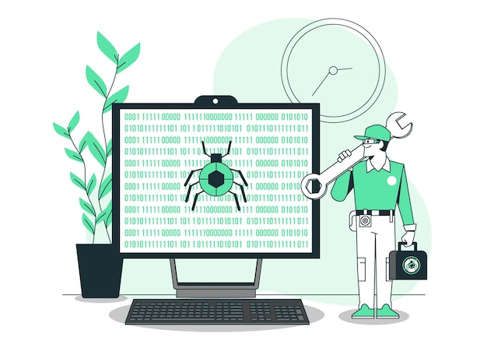
MAJOR PROJECT
CROP DISEASE DETECTION
AND PESTICIDE SUGGESTION USING DEEP LEARNING

Slide 3
OBJECTIVES
INTRODUCTION
ABSTRACT
DEEP LEARNING FOR CROP DISEASE DETECTION
TRADITIONAL METHODS OF PLANT DISEASE DETECTION
ADVANCEMENTS IN PLANT DISEASE DETECTION
DATA COLLECTION AND PREPROCESSING FOR DISEASE DETECTION
PESTICIDE SUGGESTION BASED ON DEEP LEARNING
CHALLENGES AND LIMITATIONS
FUTURE PROSPECTS
CONCLUSION
REFERENCE LINKS

Slide 4

INTRODUCTION
Agriculture is a crucial sector for the global economy and food security. However, crop diseases pose a significant threat to agricultural production and food security worldwide.
The use of pesticides to control these diseases has become increasingly popular, but it can be challenging to determine when and how much to apply.
This presentation discusses the use of deep learning techniques for crop disease detection and classification, as well as pesticide suggestion.
This approach offers a promising solution to improve crop health and reduce the negative impact of pesticides on the environment.

Slide 5
ABSTRACT
A country's inventive growth is dependent on the agricultural sector. Agriculture, the foundation of all nations, offers food and raw resources.
Agriculture is hugely important to humans as a food source. As a result, plant diseases detection has become a major concern.
This approach of detecting plant leaf disease traditionally can be subjective, time-consuming, as well as expensive, and requires a lot of people and a lot of information about plant diseases.
This work is focused on implementation of Plant disease detection and classification (PDDC-Net) using deep learning models.

Slide 6

DEEP LEARNING FOR CROP DISEASE DETECTION
Deep learning is a subset of machine learning that involves training artificial neural networks to recognize patterns in data.
In the context of agriculture, deep learning can be used to detect and classify crop diseases based on images of plants.
By analyzing thousands of images of healthy and diseased plants, deep learning algorithms can learn to identify specific visual characteristics associated with different types of crop diseases.
This approach enables early detection and accurate diagnosis, which is critical for effective disease management.

Slide 7
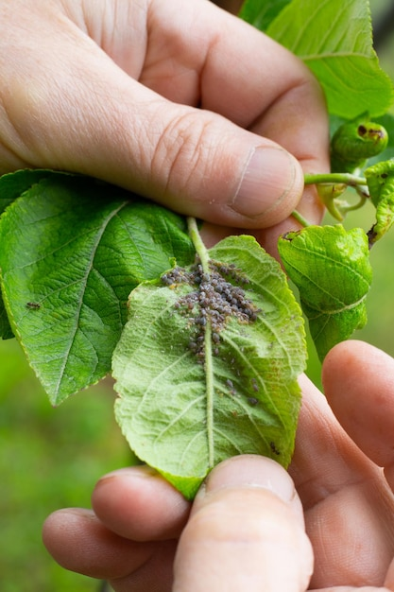
TRADITIONAL METHODS OF PLANT DISEASE DETECTION
Cultural Methods:
These involve managing plant growth conditions, such as temperature, humidity, and soil nutrients, to prevent the spread of disease.
Cultural methods can be effective in reducing the risk of infection but may not be enough to control a disease outbreak.
Chemical Methods:
These involve using chemical treatments, such as fungicides or pesticides, to control the spread of disease.
Chemical methods can be effective in reducing the damage caused by diseases but may have negative environmental impacts and can lead to the development of pesticide resistance.

Slide 8
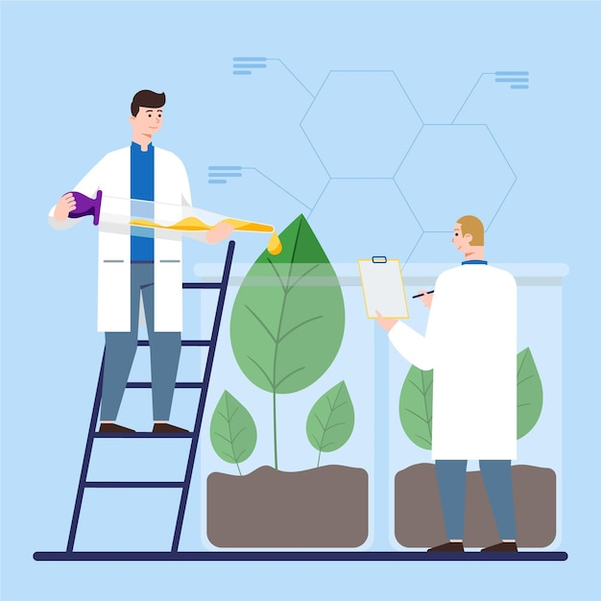
ADVANCEMENTS IN PLANT DISEASE DETECTION
Advancements in machine learning and computer vision technologies have enabled more accurate and efficient plant disease detection.
These technologies can be used to analyze large datasets of plant images and identify disease symptoms that may not be visible to the human eye.
Together, these technologies have the potential to revolutionize the way plant diseases are detected and managed.
They can also help farmers and agronomists make more informed decisions about crop management, such as when to apply pesticides or other treatments.

Slide 9

DATA COLLECTION AND PREPROCESSING FOR DISEASE DETECTION
Data collection involves capturing images of plant leaves or other plant parts that may show signs of disease. The images can be captured using cameras, smartphones, or other imaging devices.
Preprocessing involves preparing the images for analysis by removing unwanted information and enhancing the relevant features.
The quality and quantity of the data used for training machine learning models can significantly impact the accuracy of disease detection.

Slide 10

PESTICIDE SUGGESTION BASED ON DEEP LEARNING
In addition to disease detection, deep learning can also be used to suggest appropriate pesticide treatments for specific crop diseases.
This approach can help farmers optimize their pesticide use, reducing the amount of chemicals applied to crops and minimizing the environmental impact of agriculture.
It also helps to ensure that the right pesticides are used at the right time, improving crop health and productivity.

Slide 11

CHALLENGES AND LIMITATIONS
While deep learning offers a promising solution for crop disease detection and pesticide suggestion, there are still several challenges and limitations to consider.
One major challenge is the need for large amounts of high-quality data to train the deep learning algorithms effectively.
Additionally, deep learning algorithms may not be suitable for all types of crop diseases and may require additional research and development to improve their accuracy and effectiveness.

Slide 12
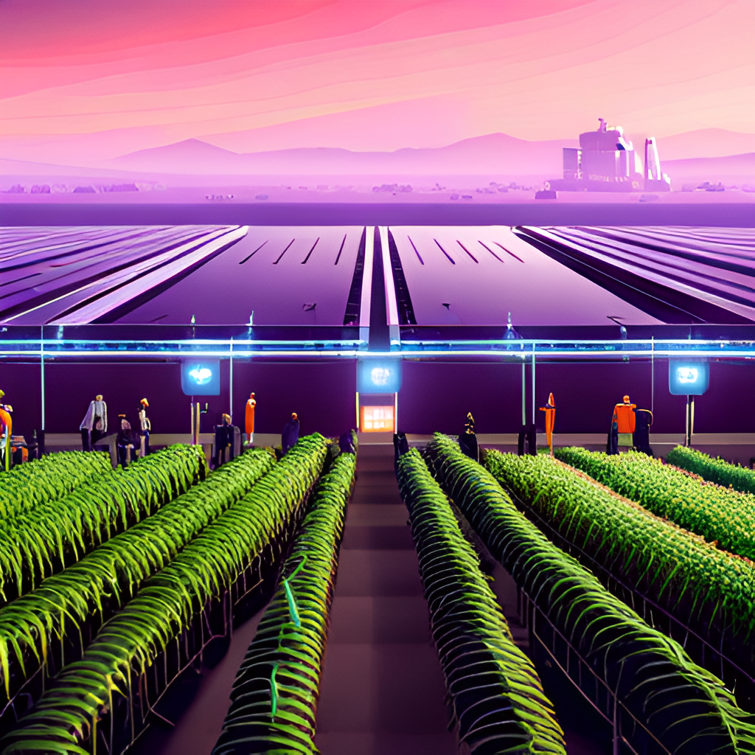
FUTURE PROSPECTS
Despite the challenges and limitations, the future prospects of deep learning for crop disease detection and pesticide suggestion are promising.
Moreover, deep learning could be combined with other emerging technologies, such as precision agriculture and robotics, to create a fully integrated system for managing crop health and productivity.

Slide 13
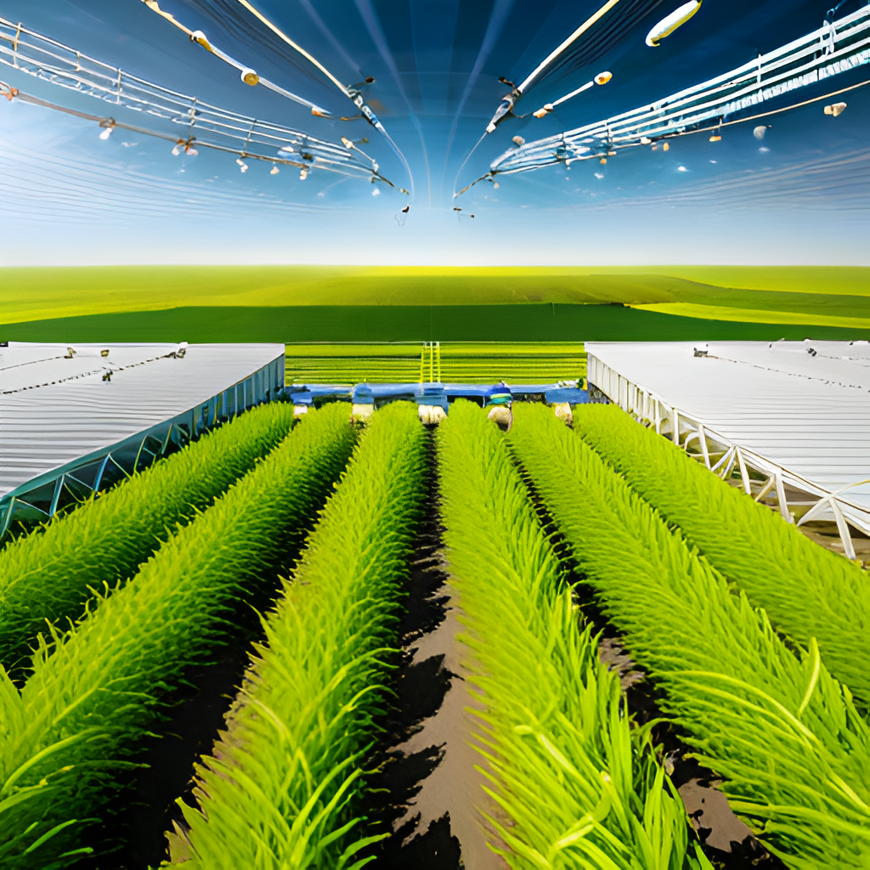
CONCLUSION
In conclusion, deep learning offers a promising approach for crop disease detection and pesticide suggestion in agriculture.
By leveraging the power of artificial intelligence, we can improve crop health, reduce the negative impact of pesticides on the environment, and create a more sustainable and efficient agricultural system.

Slide 14
REFERENCE LINKS
Plant diseases and pests detection based on deep learning: a review | Plant Methods | Full Text (biomedcentral.com)
Crop Disease Detection using Deep Convolutional Neural Networks – IJERT
Plant leaf disease detection using computer vision and machine learning algorithms – ScienceDirect
An Improved Crop Disease Identification Method Based on Lightweight Convolutional Neural Network (hindawi.com)

Slide 15

ANY QUERIES…?

Slide 16

“ THANK YOU “

